Slide 1

Programming Paradigms
Rhiannon Foster
421577

Slide 2
Paradigm
A programming paradigm is the approach that is taken towards software development.
There are three approaches:
Prodecural programming
Event driven programming
Object orientated programing

Slide 3
Procedural programming
Executes the program in a linear order (the way it was written) so that the programmer decides the sequence of the program and will jump to other parts of the program when needed.
The procedures means that there is structure in the program.
Relies on control structures such as iterations an selections.
Console based
Some examples are: C, C# Console and VB

Slide 4
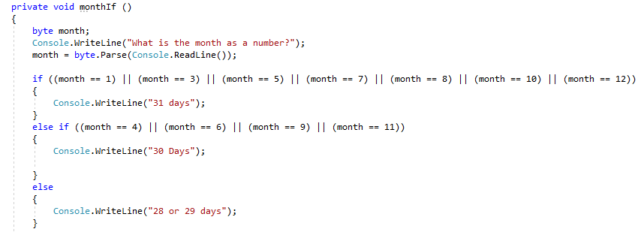
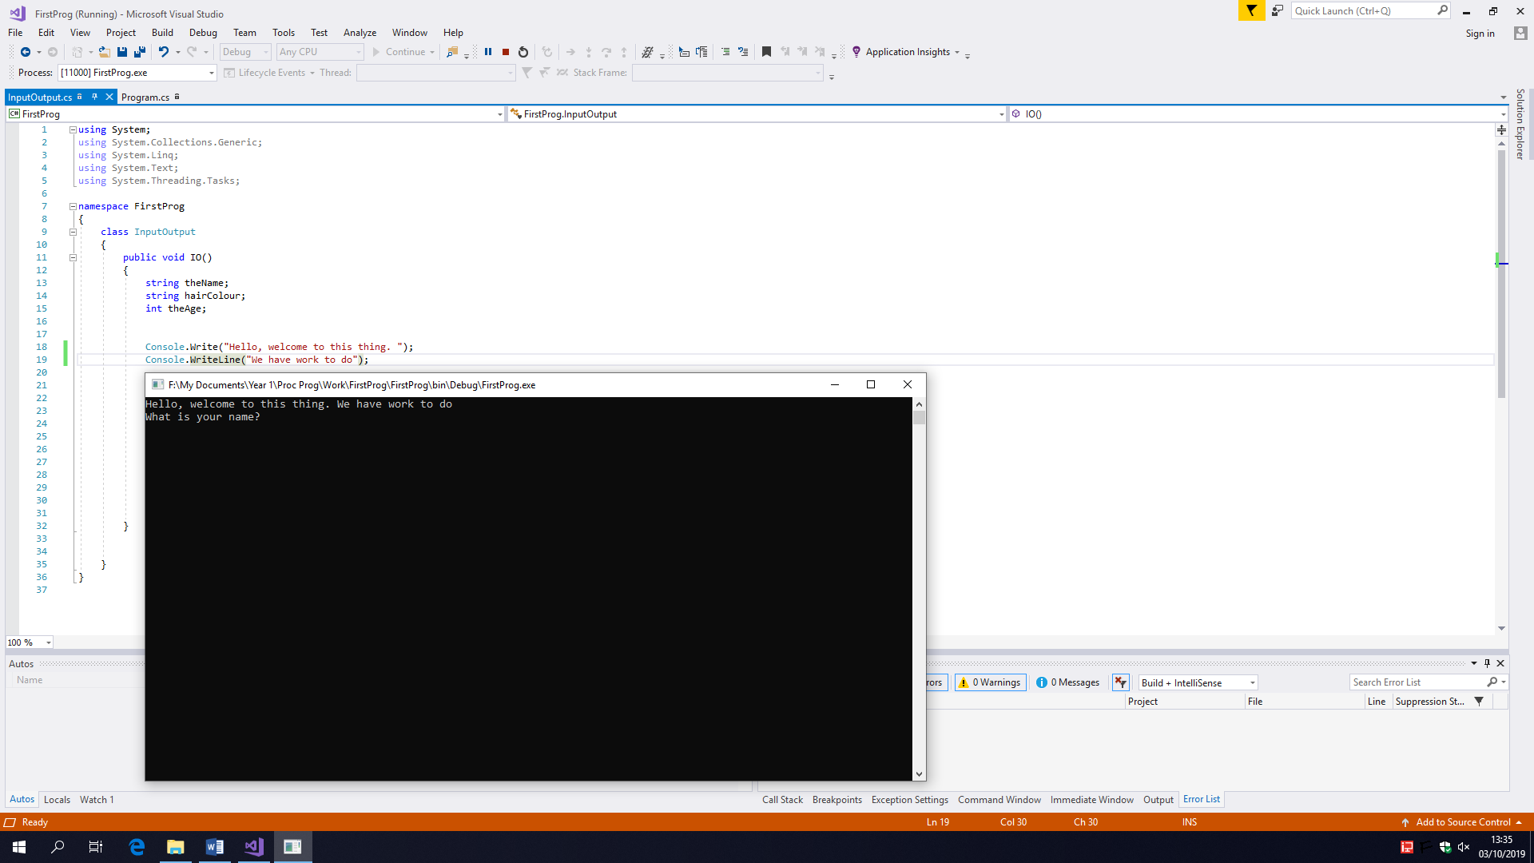
Examples of programming in c#

Slide 5
Event driven programming
Service orientated which means it responds to requests
Buttons clicks
Mouse move
Timers
Electronic generated triggers
System events
Sequence of operations is not predictable so is determined by the user or system events/ triggers
Can be GUI or non-GUI

Slide 6
Object orientated program
This is a programming model organised by objects
Data, attributes and methods
Classes describe a group of similar entities are created to objects
Reuseability
C++, C#, Java

Slide 7
Case tools and ide’s
IDE stands for integrated development environment
These are software tools that enable software developers to quickly build, test and deploy a program solution

